Slide 1


Cloud Computing and Security
BIS613D
Module 5
Cloud Programming and Software Environments
Department of ISE

Slide 2
Programming Support of Google App Engine

Slide 3
Introduction to Google App Engine (GAE)
Google App Engine (GAE) is a Platform as a Service (PaaS) for building and hosting web applications
Automatically handles scaling, load balancing, and infrastructure management
Supports apps written in multiple languages like Java, Python, Go and PHP

Slide 4
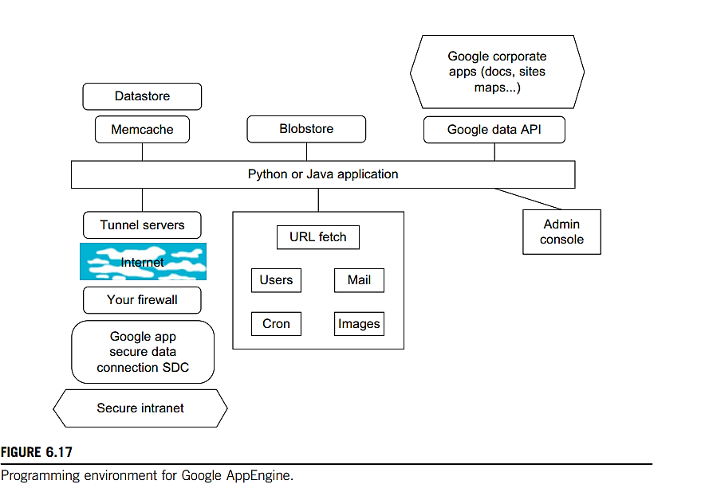
Programming Environment for
Google App Engine

Slide 5
Central Component: Python or Java Application
At the core of GAE, application is written in Python or Java.
This central block communicates with various GAE services, such as storage, APIs, and communication modules.
Datastore, Memcache, and Blobstore
Datastore: A NoSQL database where entities and properties are stored (schema-less).
Memcache: An in-memory cache to speed up data retrieval and reduce datastore queries.
Blobstore: Used to store large files (images, videos, docs) up to 2 GB.

Slide 6
Google Data API & Corporate Apps
Google Data API: Enables your app to access other Google services (Docs, Maps, Calendar).
Corporate Apps: These services (e.g., Google Docs, Sites, Maps) can be programmatically accessed via APIs.
URL Fetch and Internal Services
These services are called directly from the app:
URL Fetch: Makes HTTP/HTTPS calls to external services.
Users: Manages authentication via Google Accounts.
Mail: Sends emails via Google's mail infrastructure.
Cron: Schedules recurring tasks (daily reports, DB cleanup).
Images: Provides image transformations (resize, crop, etc.).

Slide 7
Admin Console
Allows developers to monitor, configure, and deploy applications.
Provides logs, error tracking, and service configurations.
External Communication
Secure Intranet Access:
Your app can access your private intranet systems securely using:
Tunnel Servers (through Internet),Your firewall, and
Secure Data Connector (SDC).
Internet
Represents how external connectivity (e.g., calling public APIs, webhooks, or intranet via tunnels) happens.
URL Fetch, tunnel servers, and data connectors use this path.

Slide 8
Google File System (GFS)
Google File System (GFS) is a scalable distributed file system developed by Google to support large-scale data processing workloads.
Traditional file systems couldn’t handle massive datasets, frequent hardware failures, and append-heavy workloads common in Google applications.
GFS provides high fault tolerance, efficient performance, and massive scalability.

Slide 9
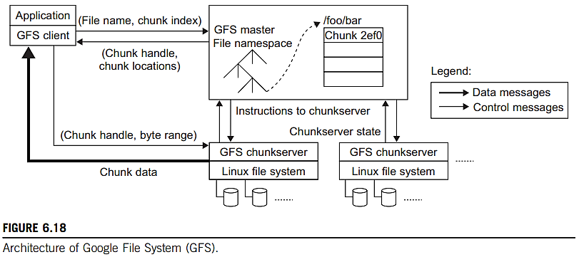
GFS Architecture

Slide 10
Single GFS Master: Manages metadata, namespace, file-chunk mapping, and chunkserver coordination.
Chunkservers: Store actual data chunks on Linux file systems. Each chunk is typically 64 MB.
Clients: Interact with the master to get chunk metadata, then communicate directly with chunkservers for data read/write.
Separation of Control and Data Paths:
Control: Between Client ↔ Master (for metadata).
Data: Between Client ↔ Chunkservers (for chunk data).

Slide 11
Replication: Each chunk is replicated (usually 3 times) across chunkservers for fault tolerance.
Efficient Data Flow: Client retrieves data location once and uses it multiple times to reduce master load.
Metadata Updates & Heartbeats: Master communicates periodically with chunk servers to maintain state.

Slide 12
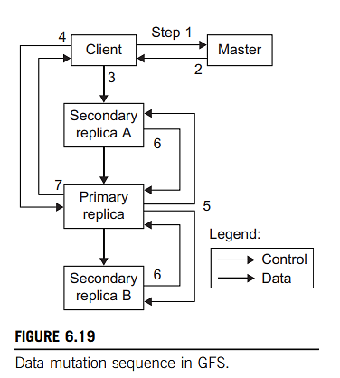
Data Mutation Sequence

Slide 13
Data Mutation in GFS
Client → Master: Requests chunk lease and replica locations.
Master Response: Sends identity of the primary replica and the secondary replicas.
Client → All Replicas: Pushes data to all replicas (data buffered).
Client → Primary Replica: Sends write command referencing buffered data.
Primary Replica → Secondaries: Sends serialized mutation requests.
Secondaries → Primary: Acknowledge mutation completion.
Primary → Client: Confirms operation completion.

Slide 14
BigTable, Google’s NoSQL System
A distributed, scalable NoSQL database developed by Google.
Designed for structured and semi-structured data.
Supports high-throughput read/write operations at massive scale.

Slide 15
BigTable Use Cases at Google
Web Data Storage: URLs, page contents, metadata, page ranks.
User Data: Preferences, search history, emails.
Geolocation Data: Satellite imagery, roads, annotations for Google Maps/Earth.
Application Examples: Google Search, Gmail, Orkut, Google Maps, Google Earth.

Slide 16
Key Components of BigTable Infrastructure
GFS (Google File System): Stores persistent data.
Scheduler: Manages execution of background jobs.
Chubby Lock Service: Handles master election and service coordination.
MapReduce: Used for bulk data processing (read/write operations).

Slide 17
Bigtable Architecture Overview
Distributed Multilevel Map:
Key → Row
Column Family → Group of related columns
Timestamp → Multiple versions of a cell
Scalable & Fault-Tolerant:
Thousands of servers
Terabytes of memory
Petabytes of disk data

Slide 18
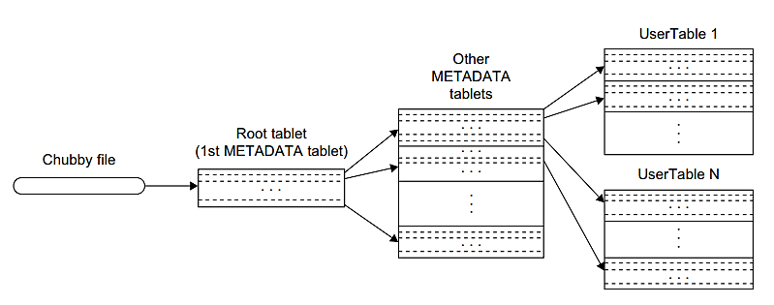
Tablet Location Hierarchy

Slide 19
Step 1: Chubby File
Stores the location of the Root Tablet (first METADATA tablet).
Ensures reliable access using Google’s Chubby lock service.
Step 2: Root Tablet (1st METADATA tablet)
Points to all other METADATA tablets.
Never split, ensuring a stable root for fast lookups.
Step 3: Other METADATA Tablets
Store mappings from user table ranges to their tablet locations.
Keys are encoded with table ID + end row.
Step 4: User Tables (UserTable 1 to N)
Actual user data is split across tablets and located via METADATA.
Supports fast, scalable access to structured data.

Slide 20
Key Features of Table Location Hierarchy
3-level hierarchy ensures efficient tablet discovery.
Scalable: Works for thousands of tables and tablets.
Fault-tolerant: Root location protected via Chubby.
Optimized for fast reads/writes at massive scale.

Slide 21
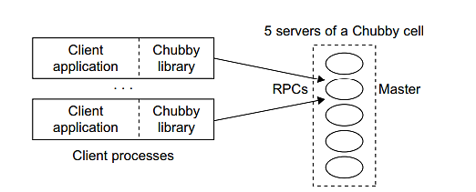
Chubby, Google’s Distributed Lock Service

Slide 22
Chubby is Google’s distributed lock service used for coordination and synchronization across distributed systems.
Each Chubby cell has 5 servers (with one elected as Master) using the Paxos protocol for fault tolerance and consistency.
Provides a coarse-grained locking mechanism and stores small configuration files in a simple file system-like namespace.
Client applications communicate via RPCs through the Chubby library to perform operations like reading/writing files or acquiring locks.
Used by GFS and BigTable to elect primaries and manage metadata reliably in the presence of failures.

Slide 23
THANK YOU

